Slide 1


PROJECT OVERVIEW
Movie Recommendation System
Too many choices. Too much time deciding. Our system recommends movies that are both similar and popular — matching the user's taste, not just random hits.

Slide 2

Three-Part Architecture
Data Engineering
Recommendation Model
Gradio App
Raw data → processing → model → recommendations → user.

Slide 3


Data Cleaning
Validate Fields
Remove Invalid Ratings
Why It Matters
userId & movieId are numbers; rating is decimal.
Bad data leads to wrong recommendations.
Valid ratings range from 0.5 to 5.0.

Slide 4

Sparse Data Problem
Most users rate only a few movies out of thousands — creating many empty values.
Keep Active Users
Keep Popular Movies
Users who rated enough movies.
Movies with enough ratings.

Slide 5


User-Item Matrix
Each row is a user. Each column is a movie. Each cell is a rating.
Example: User 10 rated Movie 5 with 4 stars → cell = 4.
Transforms raw rating data into a format the AI model can understand.

Slide 6




MODEL 1
Popularity Baseline
Average Rating
Mean score per movie.
Rating Count
How many users rated it.
Backup Role
Falls back when no similar movies found.

Slide 7

Collaborative Filtering
Learns from user behavior — no genre or story needed.
If two movies are rated similarly by many users, they are considered similar.
Calculates movie-to-movie similarity. The main AI technique in our project.

Slide 8
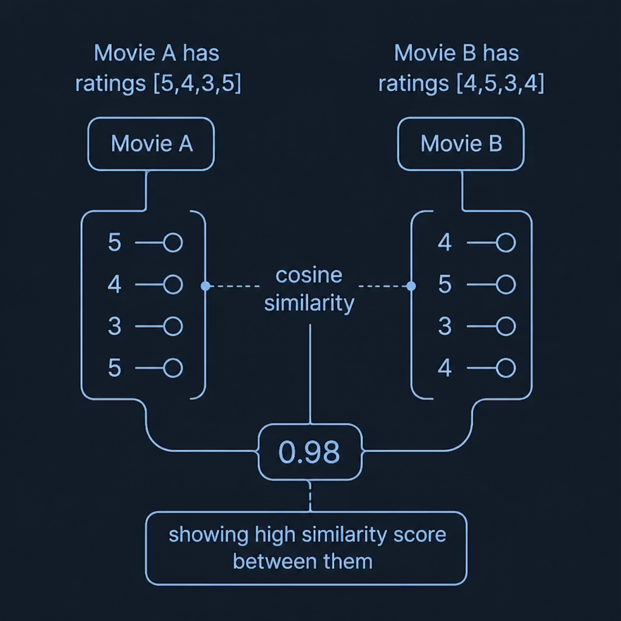
Cosine Similarity
Compares two movies as rating vectors. Similar rating patterns → high score. Different → low score.
cosine_similarity(matrix_filled.T)
.T transposes the matrix so movies compare with movies.

Slide 9


Recommendation & Gradio App
01
Check Movie
Exists in similarity table? If not, return popular movies.
02
Find Similar
Get top K similar movies from the table.
03
Rank by Popularity
Check rating count, return final N movies.
04
Gradio Interface
User picks movie, chooses count, gets results.

Slide 10


CONCLUSION
Similar + Popular = Better Picks
Data Pipeline
AI Models
Result
Cleaning, filtering, matrix transformation.
Popularity baseline + collaborative filtering.
Similar, reliable, commonly rated — in a simple Gradio app.

